Slide 1
Course Project: Two Options
Fast track: Complete project in Data Structures Made Easy (UCSD); coursera.org/learn/data-structures-optimizing-performance (Java)
NOT: coursera.org/learn/data-structures
Register by Aug 6, complete work by Sept 11, viva date TBA
Regular track: Complete in-course project (any language other than C)
Can combine this with other course projects (e.g., Web Tech.)
Common concept: Edit Distance between two words (operations allowed: insert, modify, delete one letter at a time)
e.g., time → stime → spime → spame → space (edit distance = 4)
A twist: intermediate words must be valid English words (vocab. game)
time → tame → fame → face → pace → space (edit distance = 5)

Slide 2
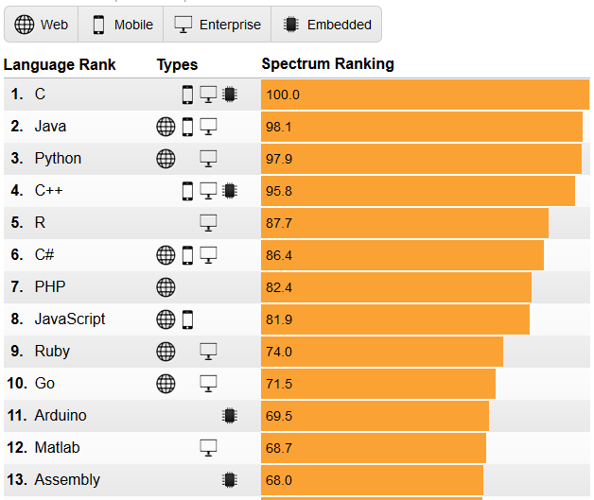
Data Structures in C
IEEE Spectrum: Top Programming Languages, July 26, 2016
spectrum.ieee.org/static/interactive-the-top-programming-languages-2016
After two years in second place, C has finally edged out Java for the top spot. Staying in the top five, Python has swapped places with C++ to take the No. 3 position, and C# has fallen out of the top five to be replaced with R.

Slide 3
Recursion
What happens when this program is compiled and run?
#include <stdio.h>
int f(int *a, int n) {
if(n == 0) { return 0; }
return a[n-1];
}
int main() {
int array[3] = {1, 2, -3};
printf("%d\n", f(array, 3));
return 0;
}
Now, let us make one modification
What is in <stdio.h>?
Pass by value? reference?
Else needed?
Address calculation
+ f(a, n-1);
f
a = array, n = 2
S
t
a
c
k
f
a = array, n = 3
main
arguments
return address
local vars
Loader

Slide 4
Structures and Pointers
A company is hiring, and wants to make relevant data of shortlisted candidates available to interviewers
in memory
typedef struct student {
double gpa;
char *github;
} student_t;
#define MAX_STUDENTS 100
int main() {
student_t list[100];
return 0;
}
Header file (.h)
list[MAX_STUDENTS];

